Slide 1
Predicting Emerging Food Trends
22 Feb, 2025 (Group 4)
I Han Chien - Jinger Chen - S Shujahat Ali – Neil Dilawari - Nikita Pawar

Slide 2
Table of Content
Executive Summary
Business Proposition
Exploratory Data Analysis
Methodologies
Analysis and Findings
Limitations and Hurdles
Future Perspectives

Slide 3
Executive Summary
Objective: Use Yelp Data to Predict Culinary trends
Goal: Identifying emerging culinary trends using Yelp data review.
Approach:
Analyze review text and business attributes to identify trending food items, cuisines, or customer preferences.
Using word frequency, Sentiment Analysis, Topic Modeling, Time Series Forecasting to detect shifts in discussions over time.
Why it matters:
Helping restaurants, investors, and food delivery platforms to identify new food trends and adapt their offerings accordingly.
Findings:
Rising interest in international Cuisines such as Tacos, dumplings etc.
American, Japanese, Italian and Mexican Cuisines dominated the insights
Pizza, Pasta and Waffles showed stable demand, indicating steady consumer interest.

Slide 4
Business Problem Definition
Develop a culinary and dish trend predictor based on reviews from restaurants to help restaurants optimize their operations and marketing

Slide 5
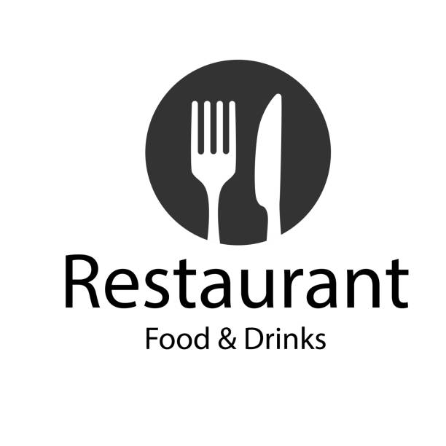


Business Relevance
1 Million Restaurants $ 1.09 Trillion Revenue 13.2 Million People Employed
> GDP of Switzerland > Population of Belgium

Slide 6

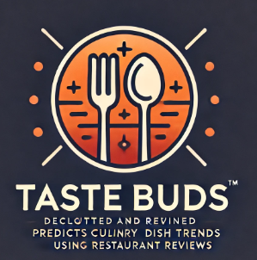






Taste Buds - A startup to keep you ahead of the trend
Trends Predictions for Cuisines and Dishes
Menu Optimization viz a viz Trends and Dietary Considerations
Neighbourhood Healthiness Tracker and Index
Restaurants Healthiness Index
Culinary Tourism Guide
Restaurant Investment and Operations Optimization
Suppliers Inventory Planning and Ordering Recommendation

Slide 7
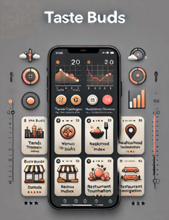
Taste Buds - User Interface and Product Features
Over 1,000,000 Restaurants covered
7 Product Lines and endless possibilities
7,000,000 + Reviews covered
Artificial Intelligence based Real Time Analysis

Slide 8
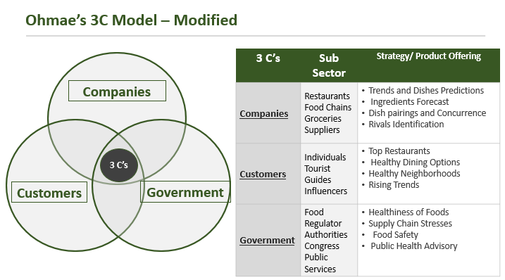
Framework to solve the Problem Slide to be added

Slide 9

Why Philadelphia

Slide 10
Why Philadelphia
Diverse Food Scene & Cultural Fusion
Home to iconic dishes – Philly Cheesesteak, Roast Pork Sandwiches, Soft Pretzels
Ethnic Diversity – Rich influence from immigrant communities
Thriving Restaurant Industry & Trend Adoption
Over 6,000 restaurants – A mix of Michelin-starred venues, family-owned spots, and fast-casual innovators. Philly often adopts national food trends early (e.g., plant-based dining, artisanal bread, and Korean BBQ). Rising foodie culture – A hub for experimentation with pop-ups, food trucks, and hyper-local sourcing.
Rich Review Data for Analysis
Large volume of Yelp reviews, allowing deep insights into customer sentiment & emerging trends.
🌆 Diverse culinary landscape + 📈 Trend adoption hub + 🛒 Rich data availability → 🚀 Ideal city for food trend prediction!

Slide 11

Data Preprocessing – Process Followed
Merge and filter data to make reduce size and reduce the need to run code repeatedly by converting it to CSV
Data Pre-Processing
Merged Business and Reviews on Business_ID
Filtered for PA
Filtered for Philadelphia
Filtered for Restaurants in categories
Download CSV (1.32 GB)

Slide 12

Data Preprocessing – Reducing and Filtering Data Size
Final Data (117869, 8)
Increased processing speed, relevant data and parallel development and analysis enablement

Slide 13
Data Preprocessing Current Data Structure
Keeping the relevant data for quick and robust analysis and parallel working
Columns
stars_x > 3
useful non zero
text reviews
Postal Code
review_count no restriction
is_open = 1
Months 1-12
year 2013 - 2016
Assumptions: Star 4 or 5 because positive experience leads to trend
Useful non zero
Business is open
2013 to 2016 saw no economic, tech or health related disruption

Slide 14
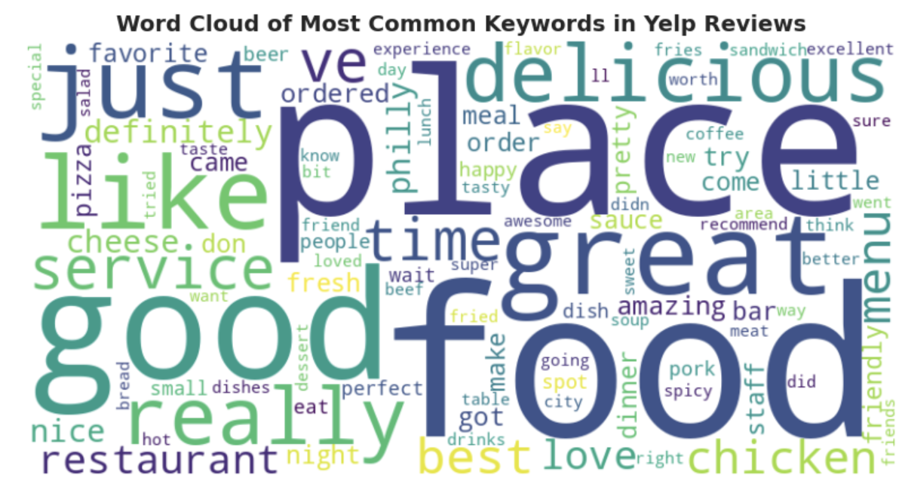
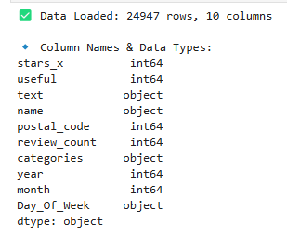
Final Data Structure and Word Cloud

Slide 15
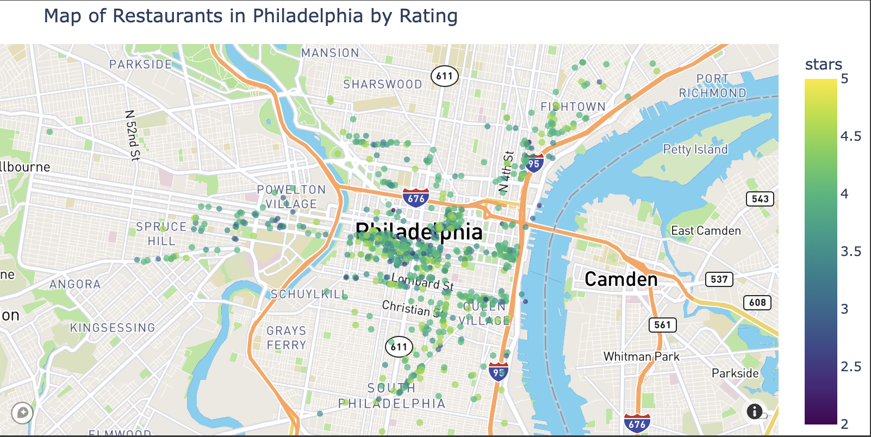
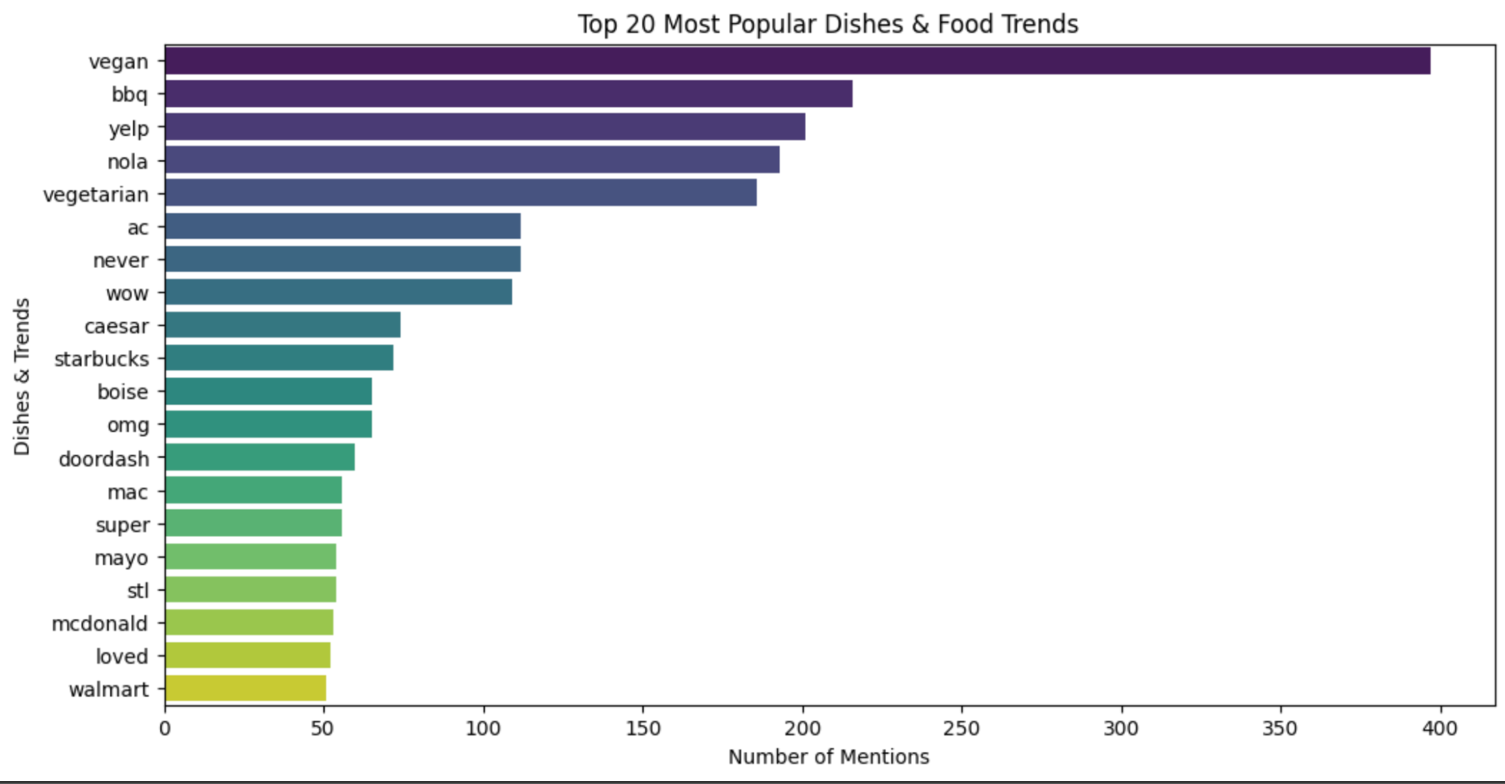
Geographic Breakdown & Most Popular Dishes
Most of the restaurants in center Philadelphia were rated 3.5 - 4.5 stars showing high quality of restaurants
We can see most popular dishes overall are vegan, bbq, and caesar salads…showing consumers enjoy healthy options with the occasional craving for some unhealthier options such as bbq

Slide 16
Machine Learning Methodologies Used
A host of text analysis and network analysis methods were used
Topic Modeling - LDA
Name Entity Recognition
Keyword Frequency Analysis
Network Analysis
Clustering (K-Means or DBSCAN)
Time Series Forecasting using LSTM

Slide 17
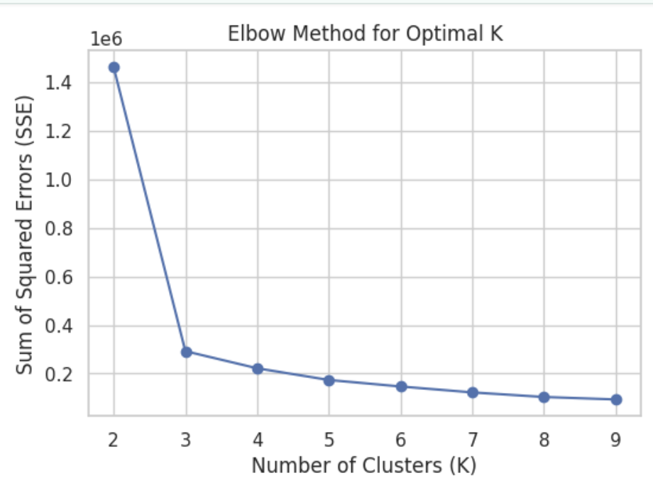
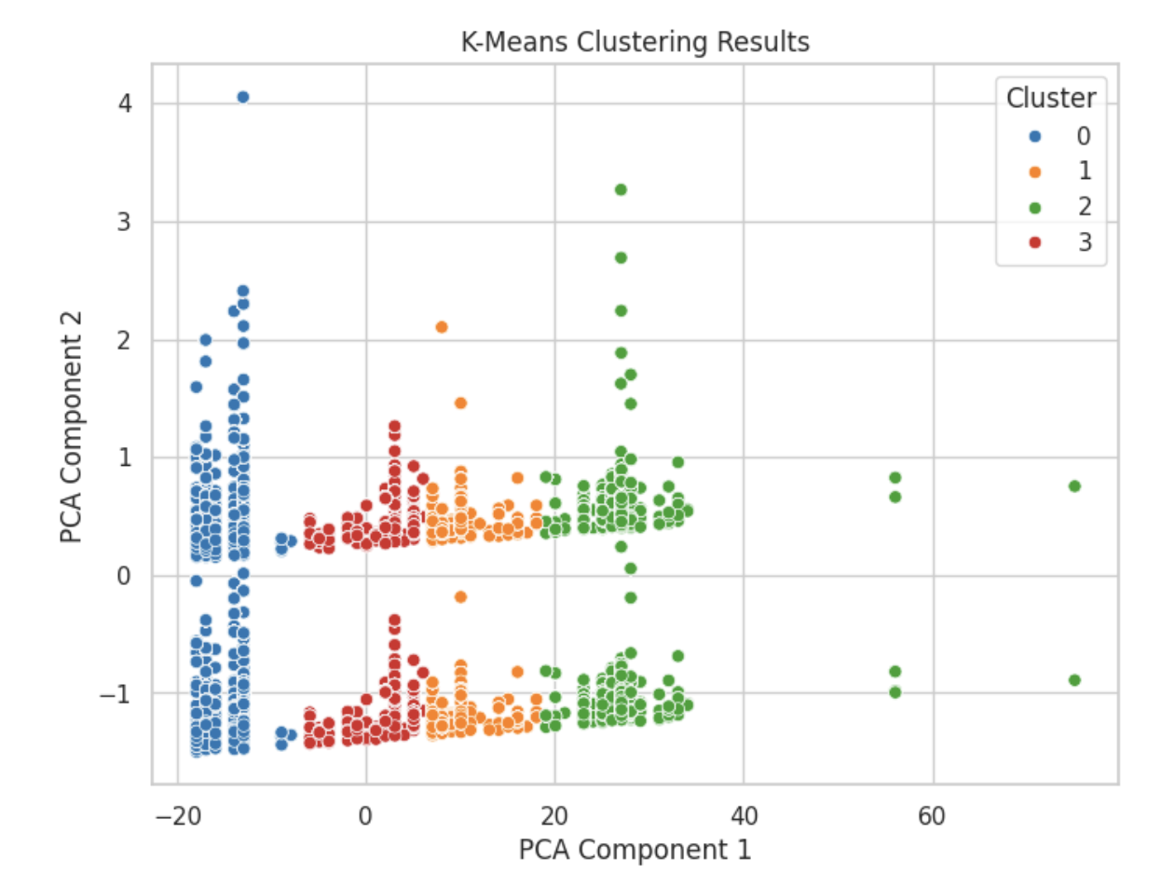
Yelp Restaurant Trend Analysis Using K-Means Clustering
Blue (Cluster 0): Budget-friendly restaurants, affordable prices, moderate ratings
Orange (Cluster 1): Mid-range restaurants, diverse cuisine, popular among customers
Green (Cluster 2): High-end restaurants, high ratings, strong customer loyalty
Red (Cluster 3): Specialty/niche restaurants, catering to specific needs
4o
K-Means clustering to categorize Yelp data into four main groups.
When K=4, the decrease in SSE (Sum of Squared Errors) slows down, indicating that K=4 is the optimal choice for better analyzing restaurant trends.

Slide 18
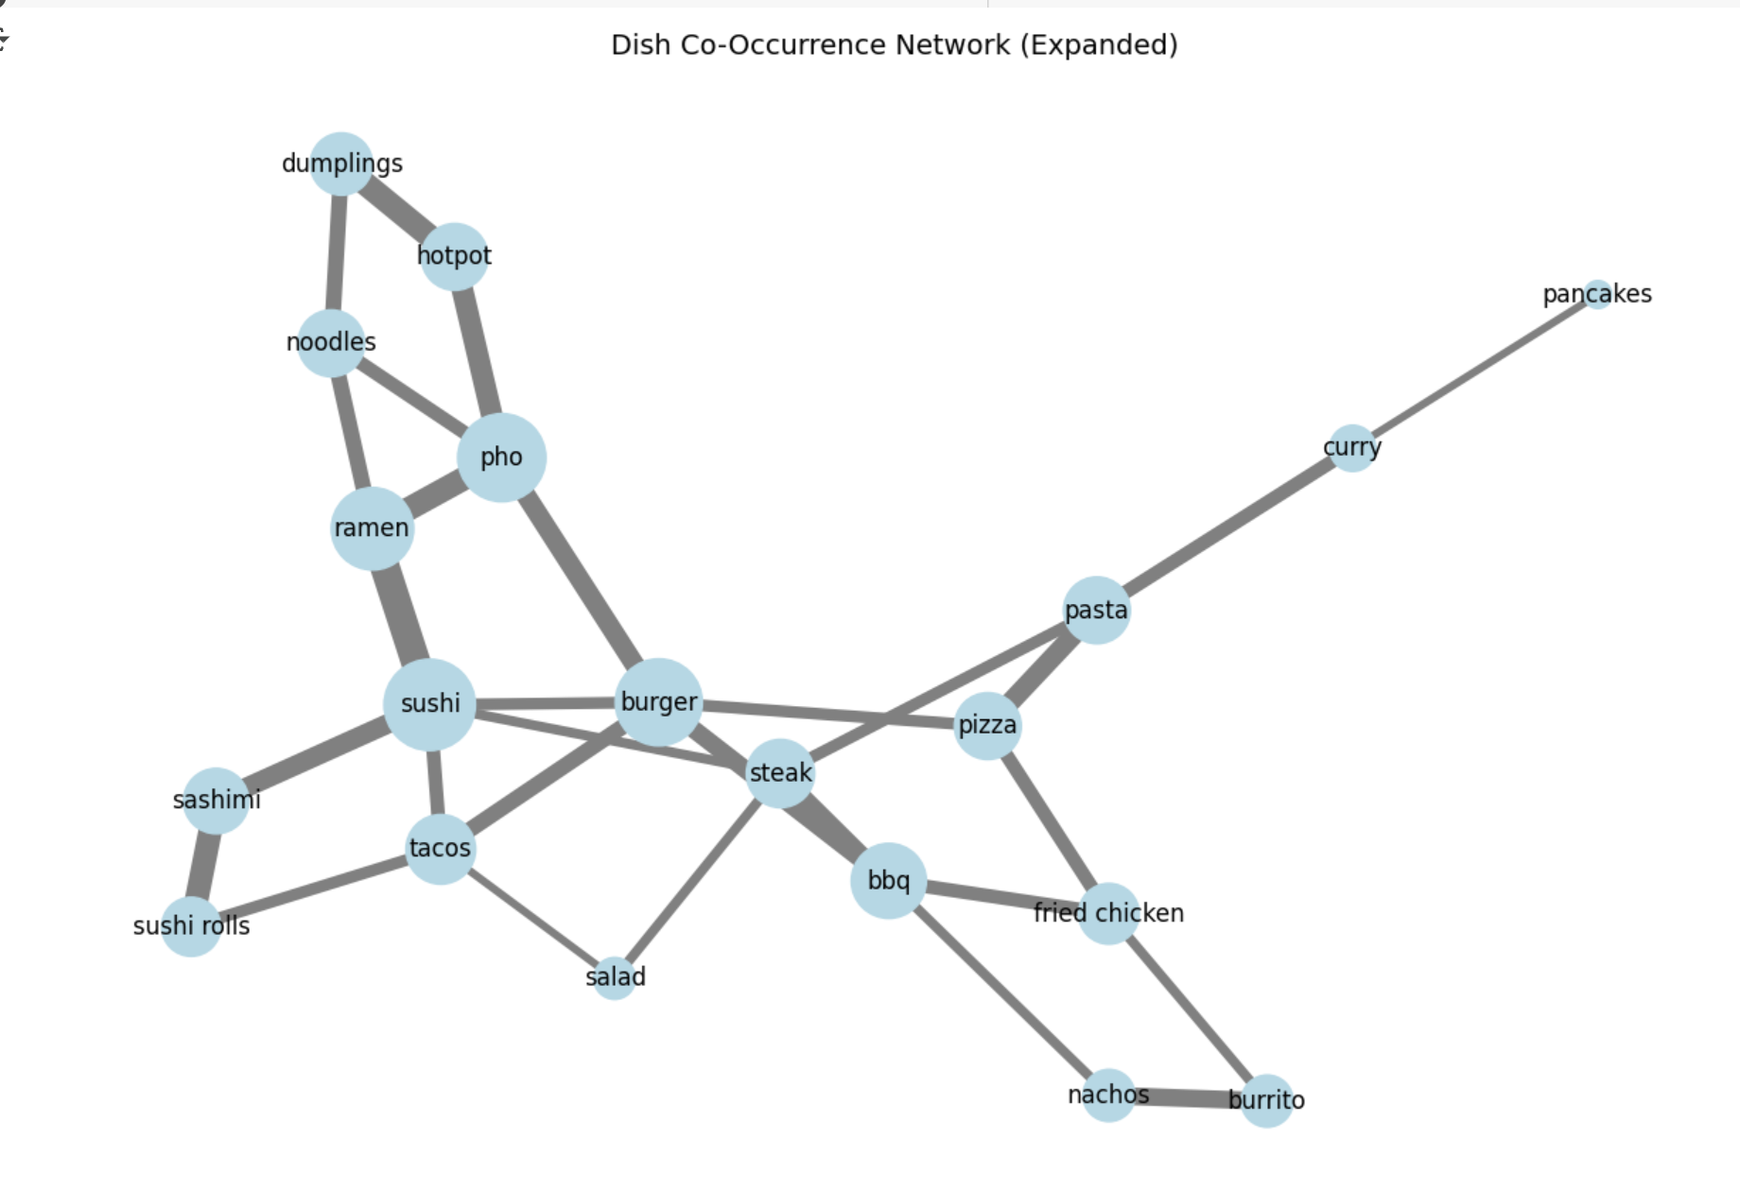
Dish Co-Occurrence Network Analysis - Menu Optimization
Asian cuisine dishes cluster strongly, signaling high cross-order potential.
Pasta and curry form distinct, less connected preference clusters.
BBQ and fried chicken co-occur, suggesting Southern cuisine synergy.
Sushi bridges diverse cuisines, indicating strong fusion potential.
Dumplings, hotpot, and ramen show strong complementary ordering trends.
Pizza and steak act as central Western dish connectors.

Slide 19
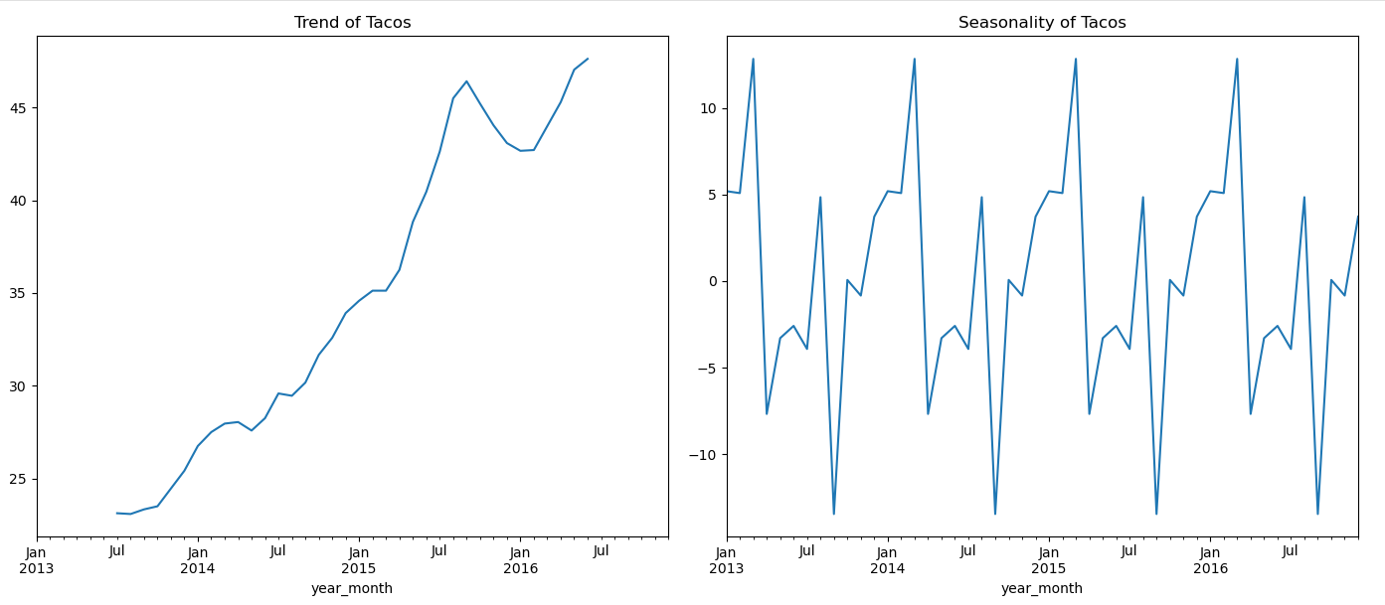
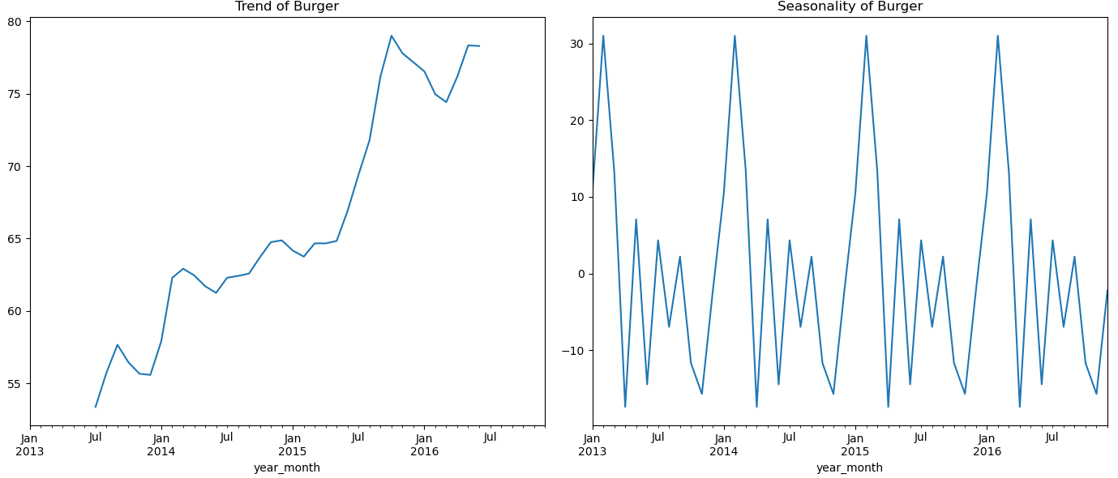
Keyword Frequency Analysis - Trends Prediction
Seasonal Changes: When Do Foods Trend the Most?
Some foods exhibit clear seasonal fluctuations in their popularity.
Tacos tend to peak in certain months, likely during the summer or around events like Cinco de Mayo.
Burgers experience higher mentions during the U.S. BBQ season (May to July), indicating a strong connection to outdoor activities and summer dining.

Slide 20
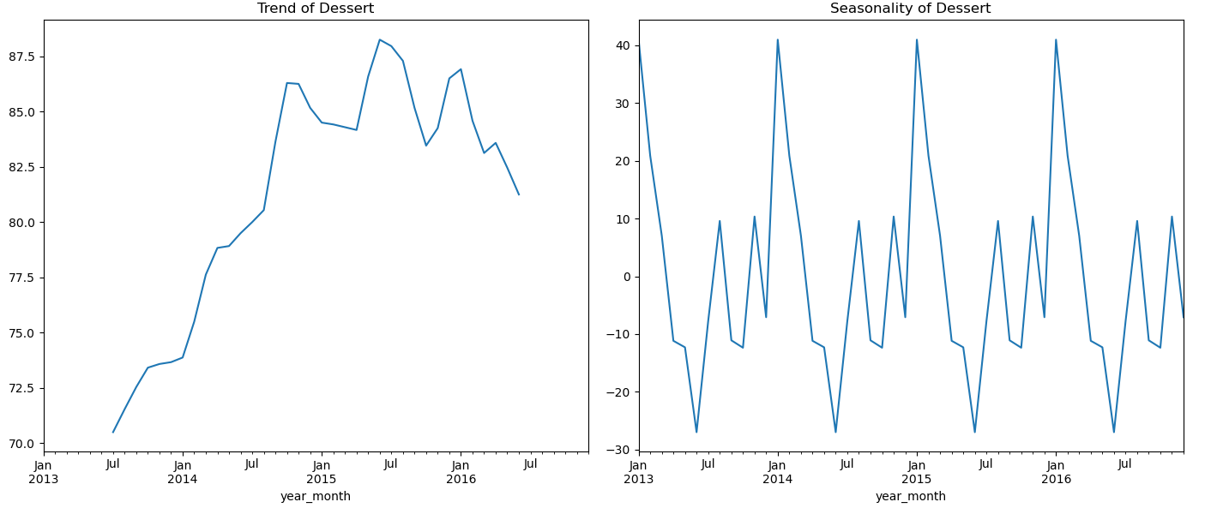
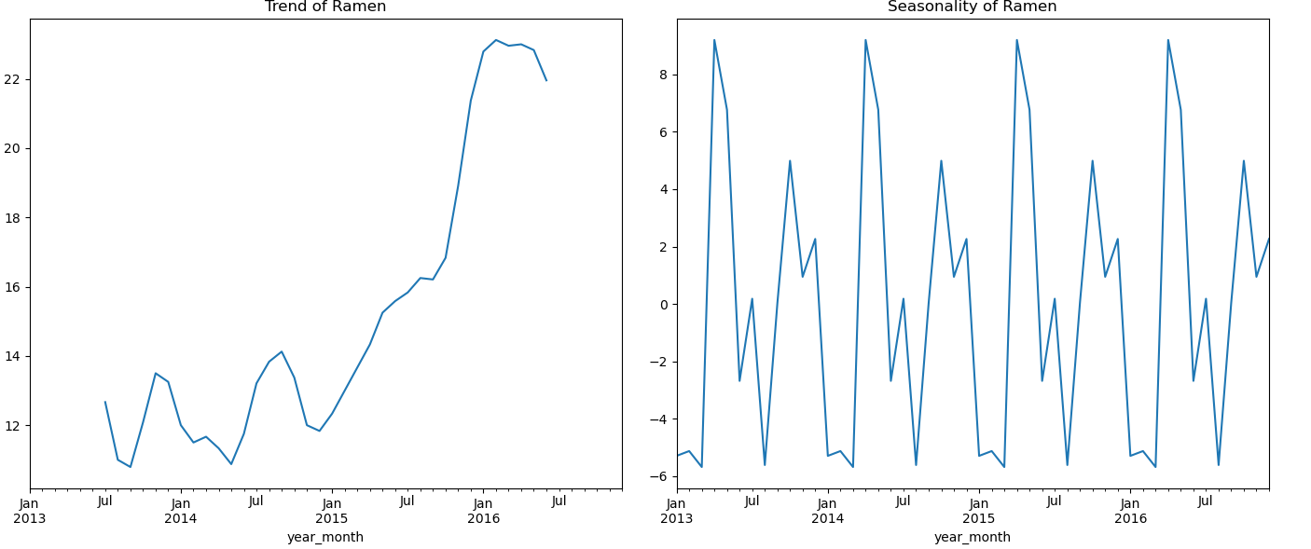
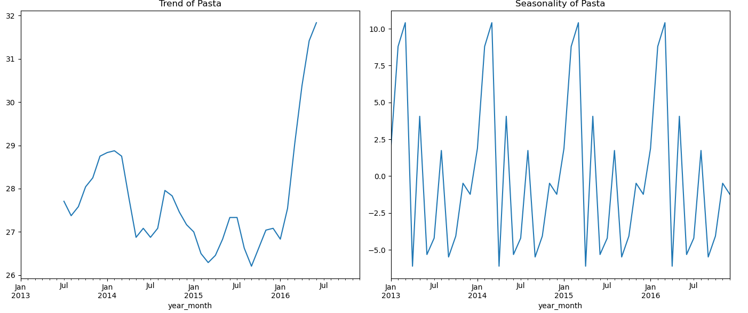
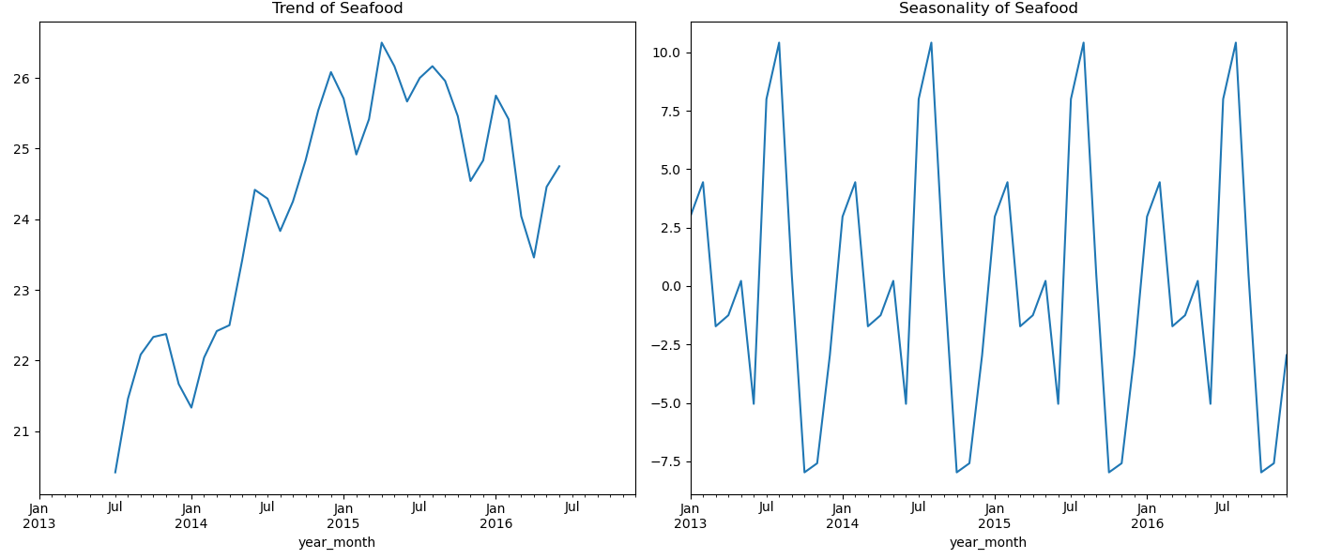
Keyword Frequency Analysis - Trends Prediction
Desserts and Pasta see increased discussions during winter months, possibly due to consumer preferences for comforting, high-calorie foods in colder weather.
Ramen and Seafood also show distinct seasonal trends, suggesting that consumer eating habits shift based on the time of year.

Slide 21
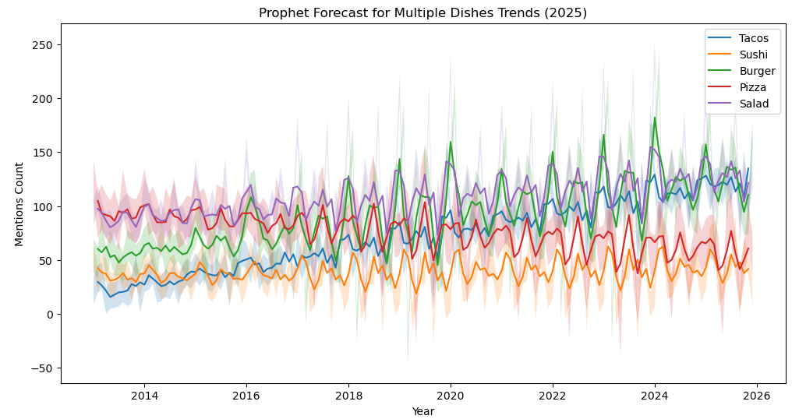
Keyword Frequency Analysis - Predicting Future Demand
Key Insights
Strong Growth in Burgers, Tacos, and Salads
Stable but Slower Growth for Pizza and Sushi
Peak demand periods align across dishes, supporting combo meal strategies.
Salad demand is volatile, indicating health-conscious seasonal shifts.
Prophet Forecast for Multiple Dishes Trends

Slide 22
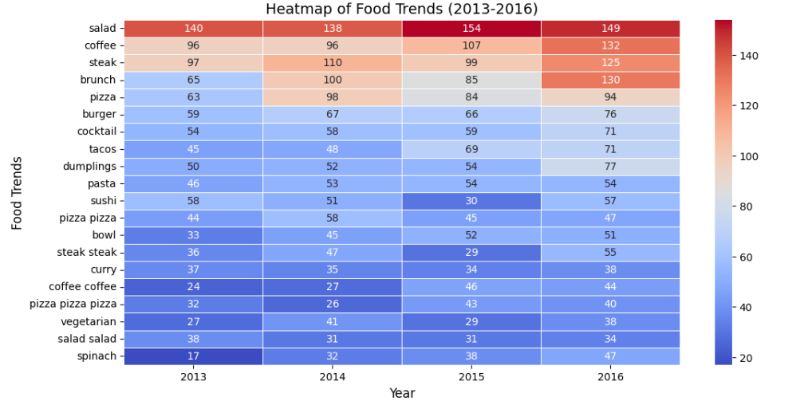
Time Series Forecasting for Food Trends Using LSTM Model
Key Food Trend Insights (2013- 2016):
Most Popular Food Trends :
Salad , Coffee, Steak
New Emerging Trends:
Dumpling and tacos - suggested growing interest in international cuisine.
Burger and cocktail trends - reflecting changes in dining and beverage preferences.
Declining Food mentions :
Sushi saw decline from year 2023- 2015 but slightly rebounded in 2016.
Curry and vegetarian mentions fluctuated, with no obvious upward trend, showing sustained but narrow appeal.
Stable Trends : Pizza, Pasta and waffles
Business Implications : Growing demand for healthy and global cuisines.
gjslgdjklj

Slide 23
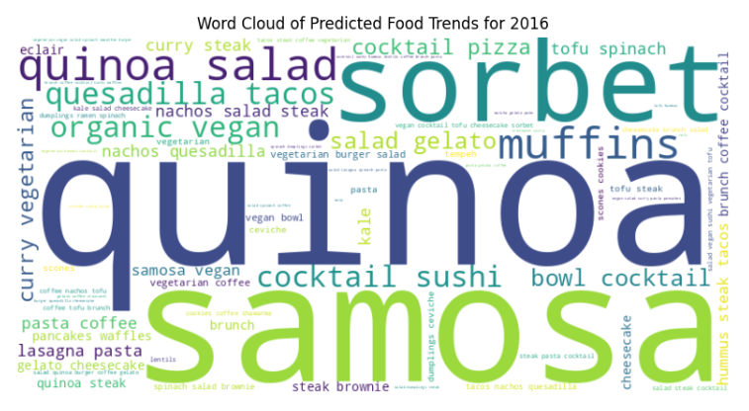
Time Series Forecasting for Food Trend Using LSTM Model
Predicted Food Trends for 2016 – Key Insights:
2016 food trends show a push towards healthier options, although ethnic flavours and desserts continue to thrive.
Restaurants, food companies, and marketers should connect their offers with these trends to remain competitive in the ever-changing food business.
The combination of wellness and indulgence represents an unique potential for market innovation.

Slide 24
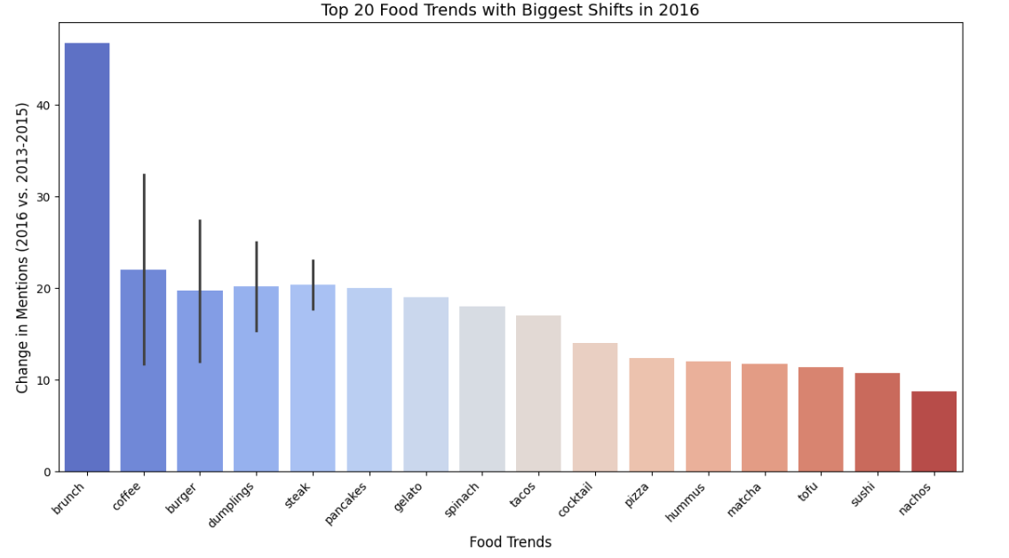
Top 20 Food Trends with Biggest Shifts in 2016
Actionable Insights:
Businesses should focus on brunch, coffee, and international cuisine as these trends have shown strong growth.
Burgers continue to thrive, likely due to gourmet and plant-based burger innovations. Dumplings gained traction, showing an increasing diversity in food preferences.
Health-conscious foods (tofu, matcha, spinach, hummus) continue to rise, presenting opportunities in vegan, organic, and functional food categories.
Specialty drinks (cocktails, coffee) are gaining traction, indicating demand for premium and craft beverage experiences.
Sushi and nachos saw a smaller increase compared to emerging food trends.

Slide 25
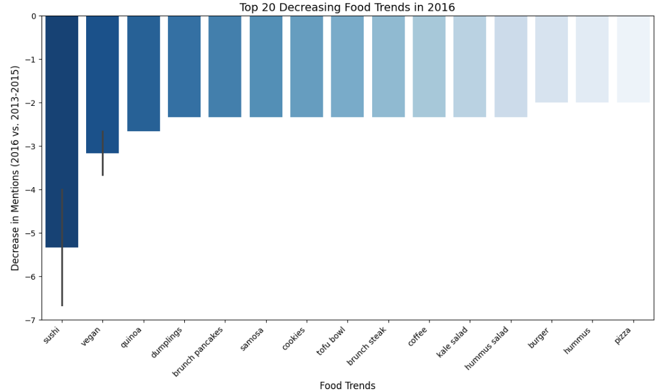
Top 20 Decreasing Food Trends in 2016
Potential causes for the declining Food Trends:
Shifting Consumer Preferences: People might be exploring newer food trends, causing previous favorites to lose traction.
Saturation of Health Trends: The hype around vegan, quinoa, and kale-based meals may have plateaued.
Emergence of New Trends: Other trends like protein-based, keto-friendly, and plant-based fast foods might be taking over.
Cultural and Lifestyle Changes: Consumers may prefer convenience-focused foods over traditional dishes requiring longer preparation.
Dumplings and Coffee shows Contradictory trends , suggesting that consumer preferences shift in specific context.

Slide 26
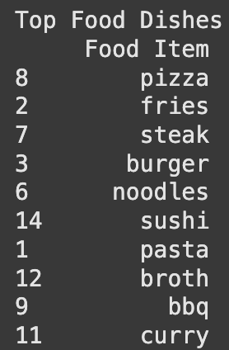
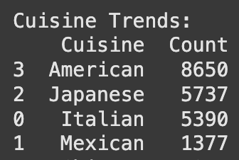
Named Entity Recognition (NER)
Based on the Named Entity Recognition Analysis, what we found is:
Most popular dishes include: pizza, fries, steak, burger, noodles, and sushi
The most popular cuisines include: American, Japanese, Italian, and Mexican
Certain items like fries and burger will remain at the top of the list due to their national popularity, especially prevalence in fast food restaurants
The prevalence of broth, sushi, and noodles show an increasing trend of Asian dishes

Slide 27
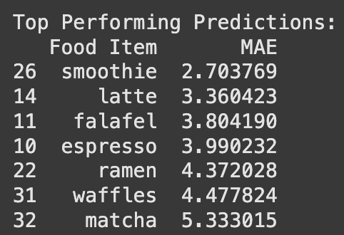
Time Series Analysis of predicting popular dishes
Insights:
Based on this table, lists food and beverage items with their MAE, to measure prediction accuracy
The model was best at predicting beverage items as some of the top performing predictions were smoothie, latte, espresso, and matcha
The single best performer in this model was smoothies

Slide 28
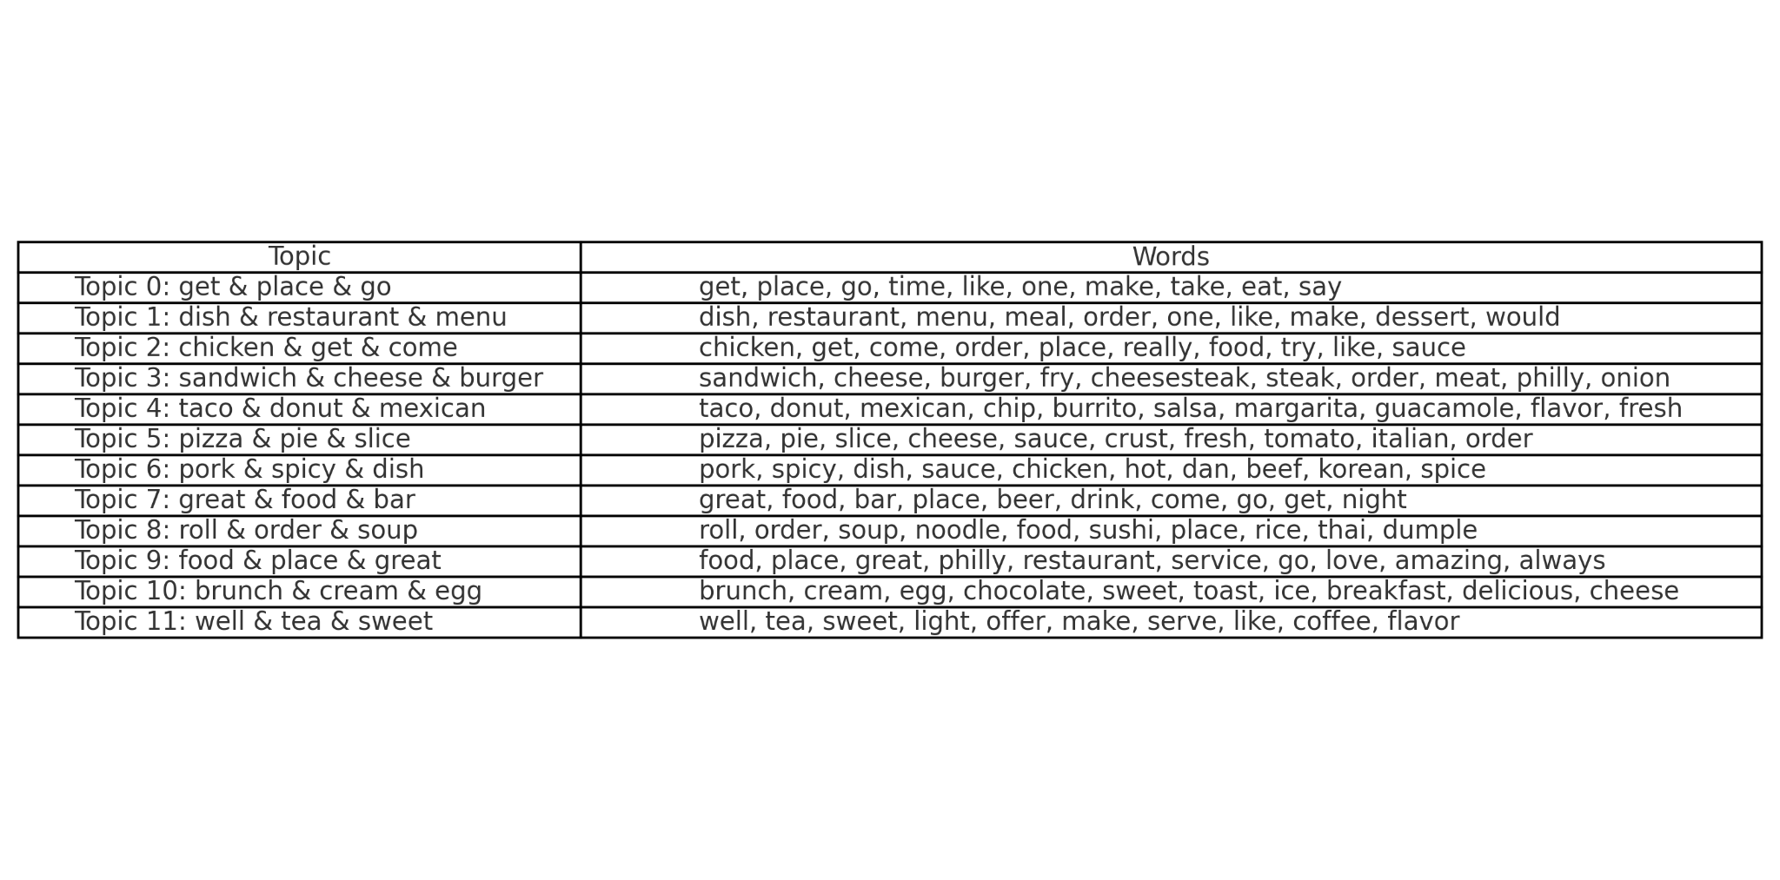
Topic Modeling with 12 Topics

Slide 29
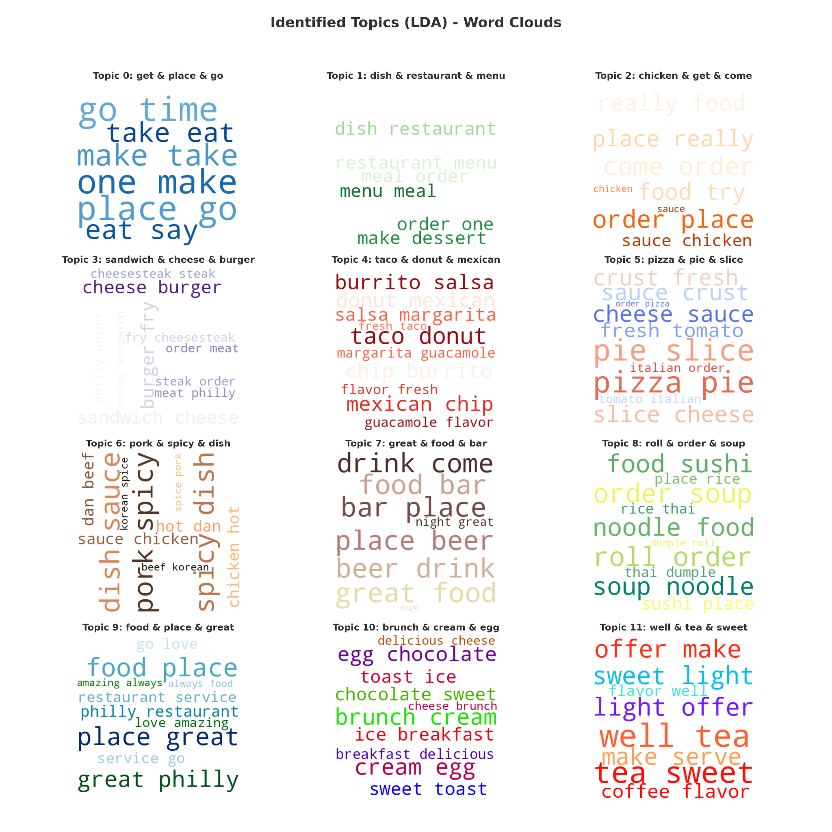
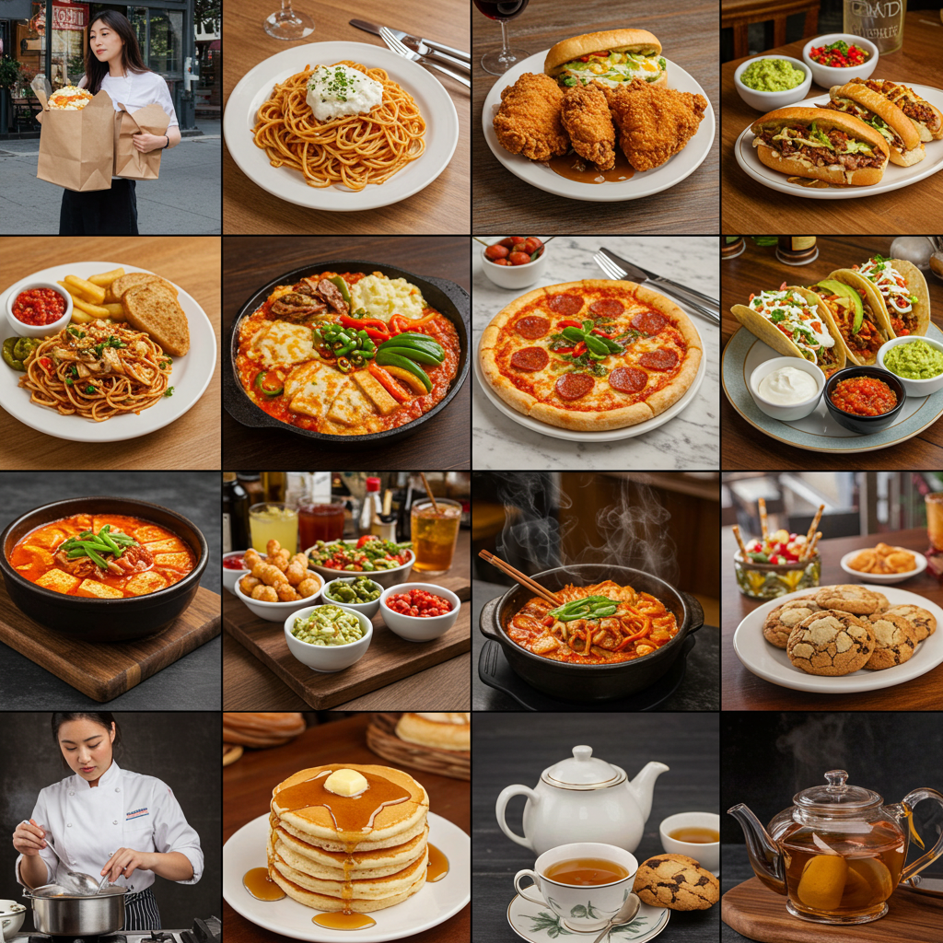
Topic Modeling to get Topics

Slide 30
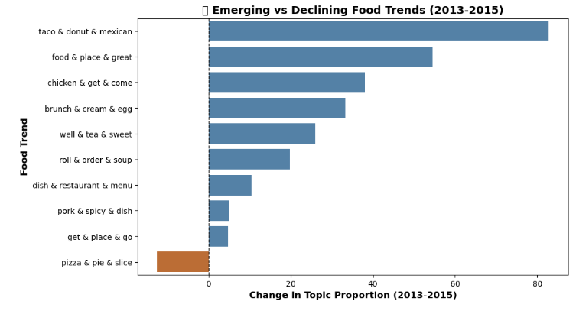
Absolute Proportion Change in Topics from 2013-2015
Takeaways: Mexican Food is fastest growing
Growth in Sushi, Pizza and fast food is slowing or stagnating

Slide 31
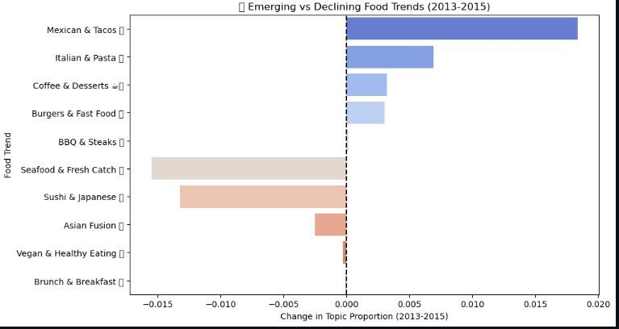
Relative Proportion Change in Topics from 2013-2015
Takeaways: Mexican Food is fastest growing
Growth in Sushi, Pizza and fast food is slowing or stagnating
Validates finding from Absolute change data

Slide 32
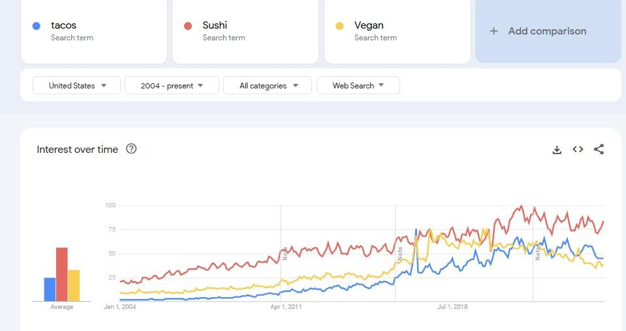
Cross Validation with Google Trends
Takeaways: Confirms finding that Tacos did grow fast
Tacos have overtaken Sushi and rolls
Validates finding from Absolute and Relative change data
Tacos have closed gap on vegan too

Slide 33
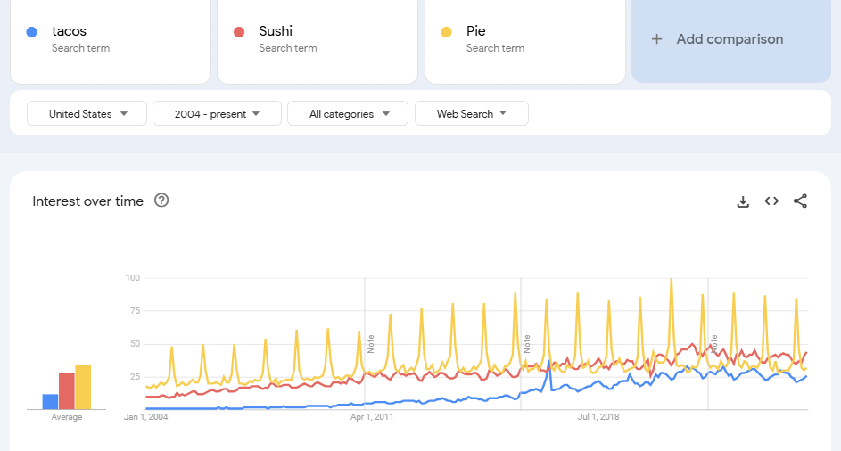
Cross Validation with Google Trends - Taco/Pie
Takeaways: Confirms finding that Tacos did grow fast
Tacos have overtaken Sushi and rolls and Pie
Validates finding from Absolute and Relative change data
Tacos have closed gap on Pie too

Slide 34
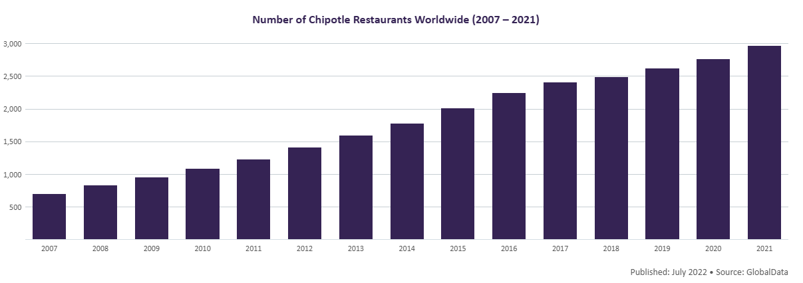
Cross Validation through Comparison with Chipotle
Takeaways: 7000 Branches and growing
2023 15% Revenue growth compared to 7% for industry
Validates finding from Absolute and Relative change data that Mexican Food is on the rise

Slide 35
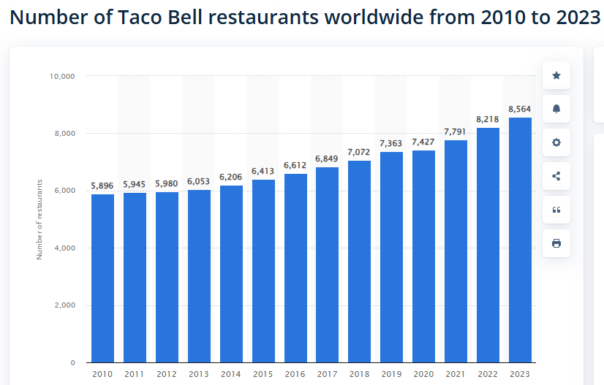
Cross Validation through Comparison with Chipotle
Takeaways: 8,564 Branches and growing
2023 5% same store Revenue growth for higher than competitors
Validates finding from Absolute and Relative change data that Mexican Food is on the rise

Slide 36
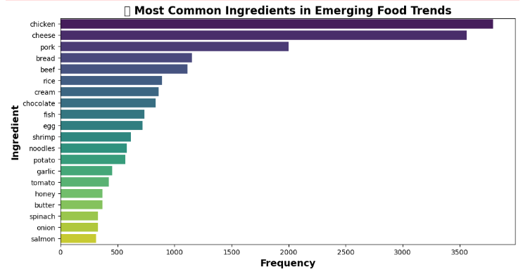
Ingredient Demand - Supplier planning and inventory
Takeaways: Chicken and cheese dominate – Most frequently used emerging ingredients.
Protein-rich trend – Pork, beef, fish, and shrimp are popular.
Diverse ingredients – Sweet, savory, and healthy foods are trending.
Staples remain strong – Rice, noodles, and potatoes still relevant.

Slide 37
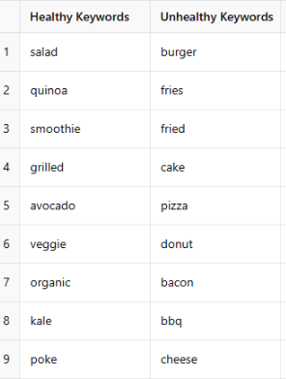
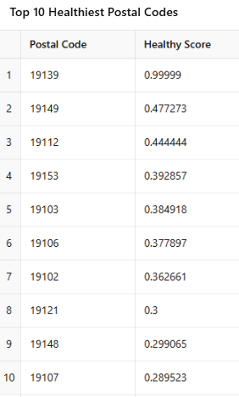
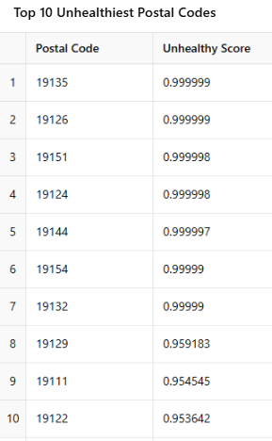
Neighbourhood Healthiness Index

Slide 38
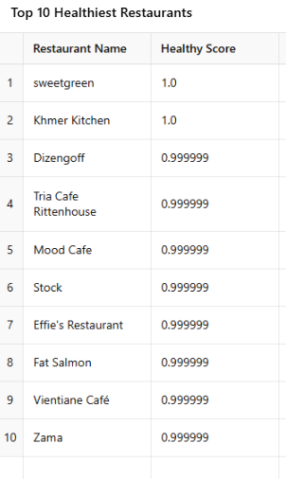
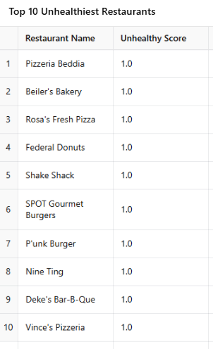
Restaurants Healthiness Index

Slide 39
Summary - Comparison of Models and Results
Model Used | Strength | Weakness | What did it predict | Why did it predict that
K-Means Clustering & Dish Co-Occurrence Network Analysis | Identifies restaurant trends and menu item associations to optimize sales | Requires predefined K value, sensitive to outliers, and can't directly predict sales | Categorized restaurants into four types (budget) and identified frequent pairings | Elbow method determined K=4, and clustering was based on PCA features.
Keyword Frequency Analysis | Simple, interpretable, effective for identifying emerging trends. | Lacks context, sentiment, and synonym handling. | Rise of plant-based food, mexican cuisine. | Based on word count shifts in reviews
Time Series Forecasting using LSTM Model | LSTM effectively predicts time-dependent correlations in food trends, forecasting shifts based on past data. | Requires a large amount of training data. Sensitive to data preprocessing and model tuning and Can be computationally expensive. | Accurately forecasted rising interest in healthy foods, international cuisine, and specialty drinks, while identifying declining trends. | Helps restaurants, marketers, and suppliers adjust inventory, menu offerings, and marketing strategies based on anticipated trends.
Named Entity Recognition Time Series | Identified popular dishes along with cuisines to prioritize strategic marketing initiatives. | Limited generalization to new entities, and Overlapping Entities (Philly, Cheesesteak, Philly Cheesesteak) | Performed really well in predicting upcoming beverage popularity | Helps smoothie cafes, coffee shops, etc in predicting future demand, along with what to focus their spending on.
Topic Modeling LDA | Unsupervised, interpretable, scalable, and effective for trend analysis. | Manual topic labeling, sensitive to parameter tuning, and fixed number of topics. | Rise of Mexican Cuisine, Brunches, tacos. Stagnation of Traditional Dishe. | Based on recurring patterns in customer reviews, identifying associations

Slide 40



Limitations
Small Dataset
Technical Issues
Pandemic Effects
Cross Platform Collaboration and Data Sharing
High Seasonality

Slide 41
Future Perspectives
Expansion across geography for other States
Developing a Similar Model for other industries say Fashion
AI based Menu Generator
Sustainability and Ethical Eating Trends
Federated Learning and in house consultancy for Customers Preference

